Slide 1
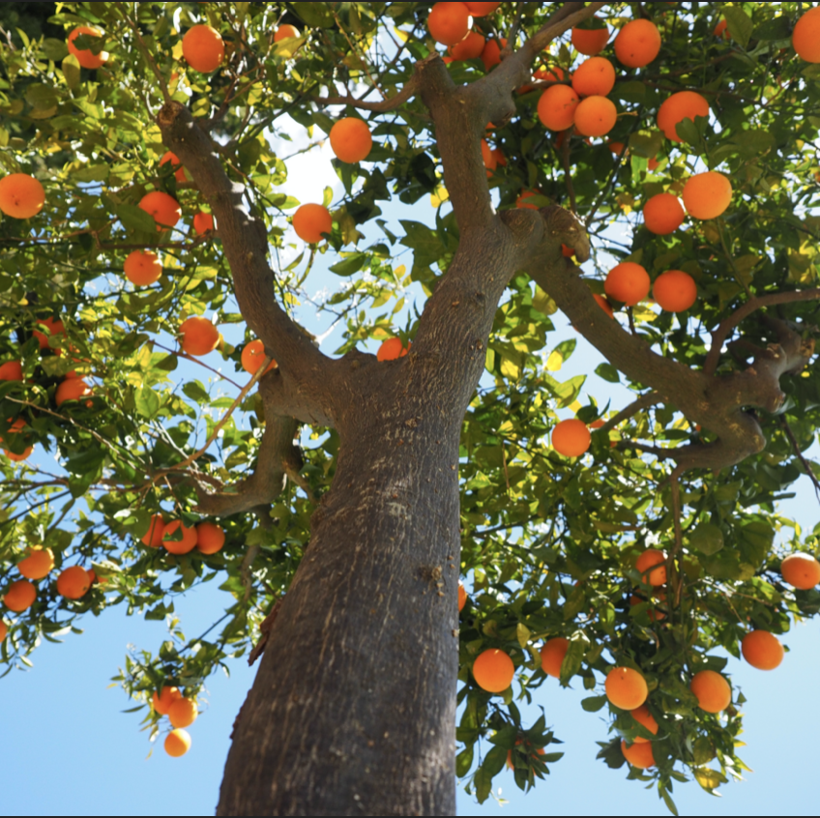
Decision Trees
Notes:
welcome

Slide 2
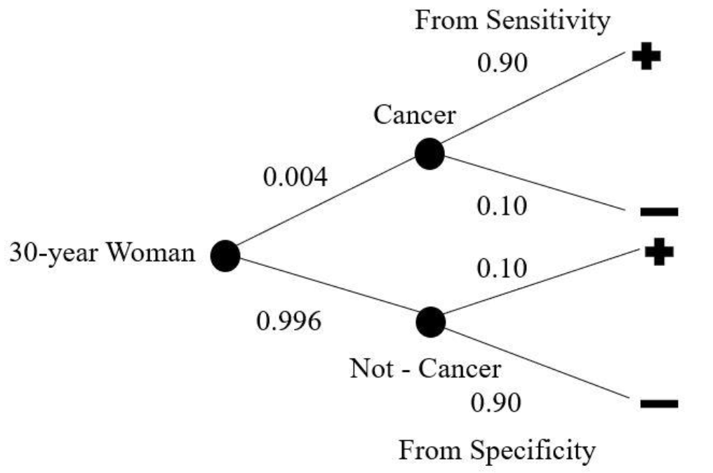
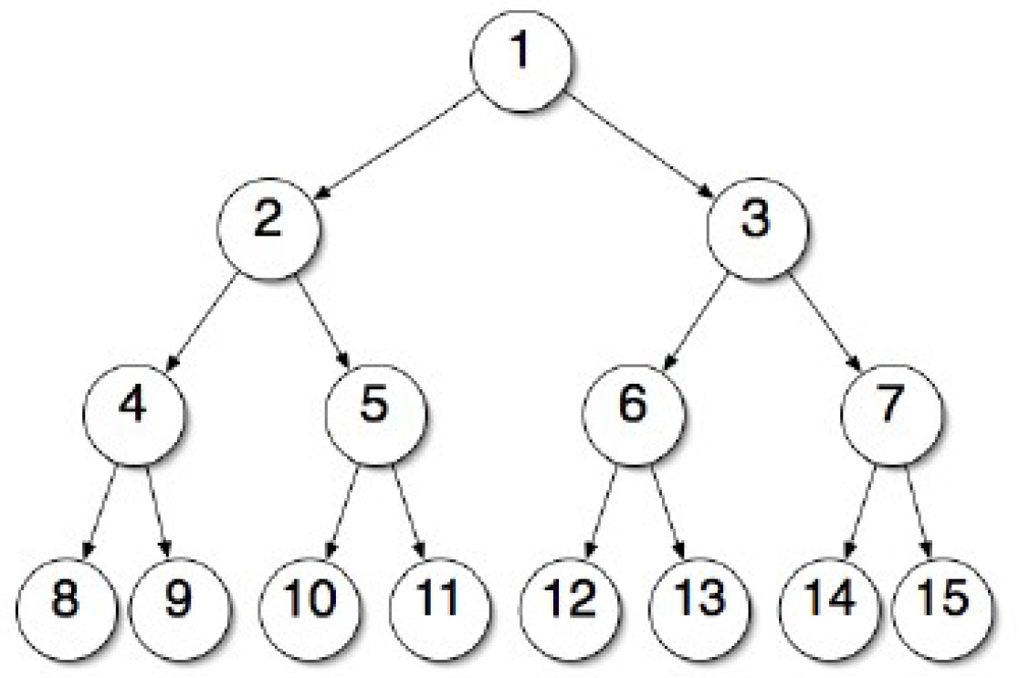
Bayes Theorem
Binary Search Tree
***
Decision Tree
Notes:
In class, we learned about Bayes Theorem and how it can be used to calculate the probability of an event happening given another event.
Additionally, we also learned about binary search trees in Graph Theory and how it efficiently searches for an element in the tree.
Decision trees can be seen as a combination of these two ideas where the simple, yet powerful idea of searching can be used to make decisions and predict outcomes.
-Decision Trees --- supervised machine learning technique --- which we have the opportunity to learn about in future courses at NEU

Slide 3
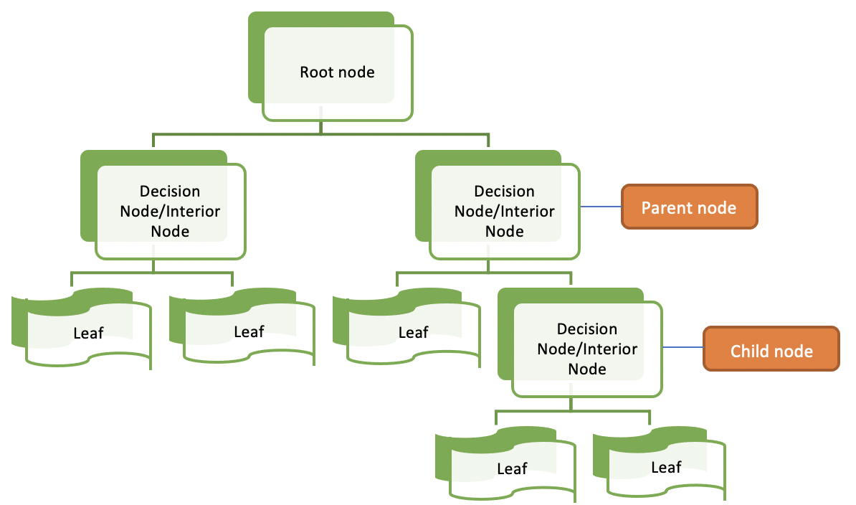
Notes:
-Decision Tree benefits – easy to understand (why often used in healthcare setting), uses numerical and categorical data
-A decision tree starts with a root node – or the criteria that best splits or classifies the data and then further refinement is made through other decision nodes until you reach a leaf node
-Examples of decision tree uses – spam/not spam and recommendation systems in Netflix/shopping etc.
-helps make decisions….. So what was our question?

Slide 4
“What items are predominantly reordered at grocery stores by customers across the United States?”
Notes:
We used the 1.3M row Instacart grocery shopping dataset released in 2017.
We were curious which was reordered more often: processed food or fresh food?
Both of us are into healthy living and hope to work in health-tech in the future, so this was a great topic that combined our interests.

Slide 5

Notes:
There are several ways to create a decision tree: two of the most popular ways are Gini Impurity and Information Gain with Entropy which will be learned about in future courses.
Since this was our first exploration of the topic for this one week project, we choose the Gini Impurity method because of it’s ease of use.
Gini Impurity measures the impurity or the probability the data will be incorrectly classified or mislabeled. The lower the Gini Impurity the better.

Slide 6

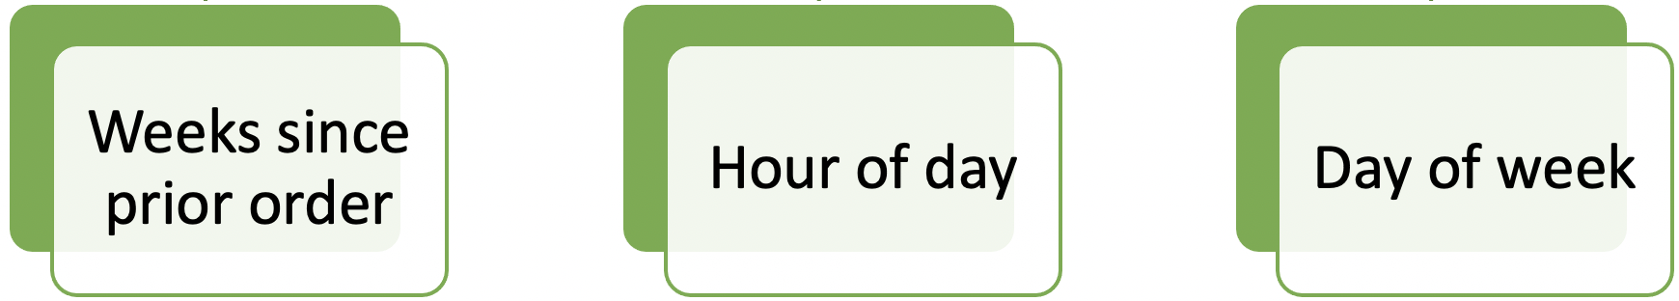
Notes:
So how do we create the decision tree?
First we decided on the possible decision nodes – the features from the dataset that would help us classify our data
Next we had to do the Gini Impurity calculations to determine which nodes went where on the tree.
The first node to calculate was the root node.

Slide 7
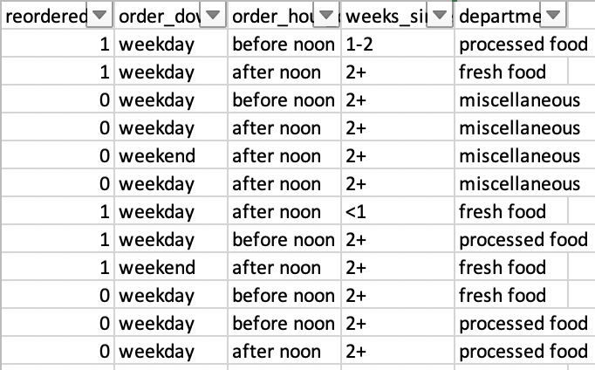
Notes:
A wise teacher told us – if you want to solve a complex problem, break it down into a smaller problem first.
So before we addressed the large dataset,
We pulled a random sample of 12 rows. We also wanted to manually calculate or create the decision tree from scratch to make sure we understood the process.
So then we started doing the Gini Impurity calculations for the 4 possible nodes.

Slide 8
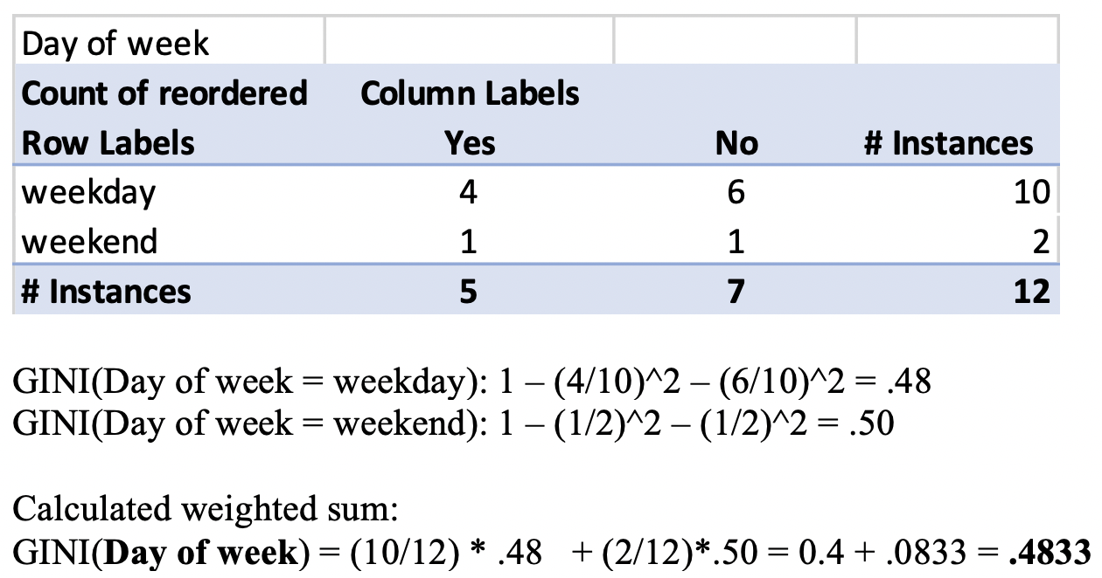
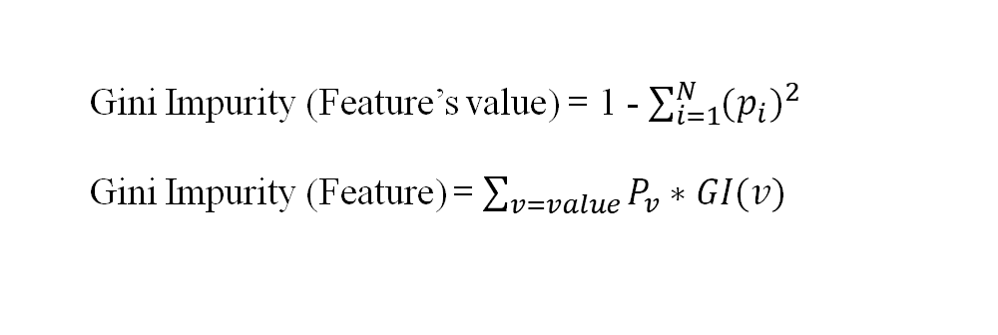
Gini Impurity (Feature’s value) = 1 - $\sum_{i=1}^{N}{{(p_{i})}^{2}}$
Gini Impurity (Feature) = $\sum_{v=value}{P_{v}∗GI(v)}$
Notes:
There are two steps in the Gini Impurity calculation
We’ll use the calculation for the feature “Day of week” as an example.
There are 2 options in Day of week: Weekday or Weekend.
We start with the 10 Weekday orders and calculate the probability of Yes reorders and No reorders, square each one then subtract from 1 because we want the impurity.
This results in a Gini Impurity of .48 for this option of the feature. We then do the same for the Weekend option.
Finally, we calculate the weighted sum. So for the 10 weekday orders out of 12, we multiply that by .48 and for the 2 out of 12 weekend orders, we multiply that by .50.
This results in a final Gini Impurity number of .4833 for the “Day of week” feature.

Slide 9
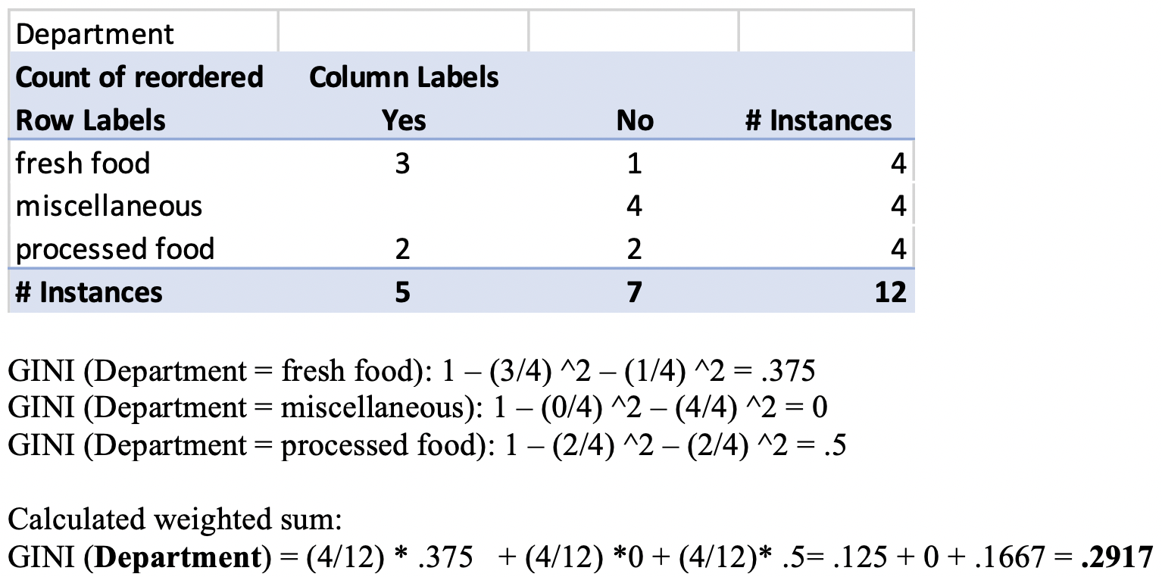
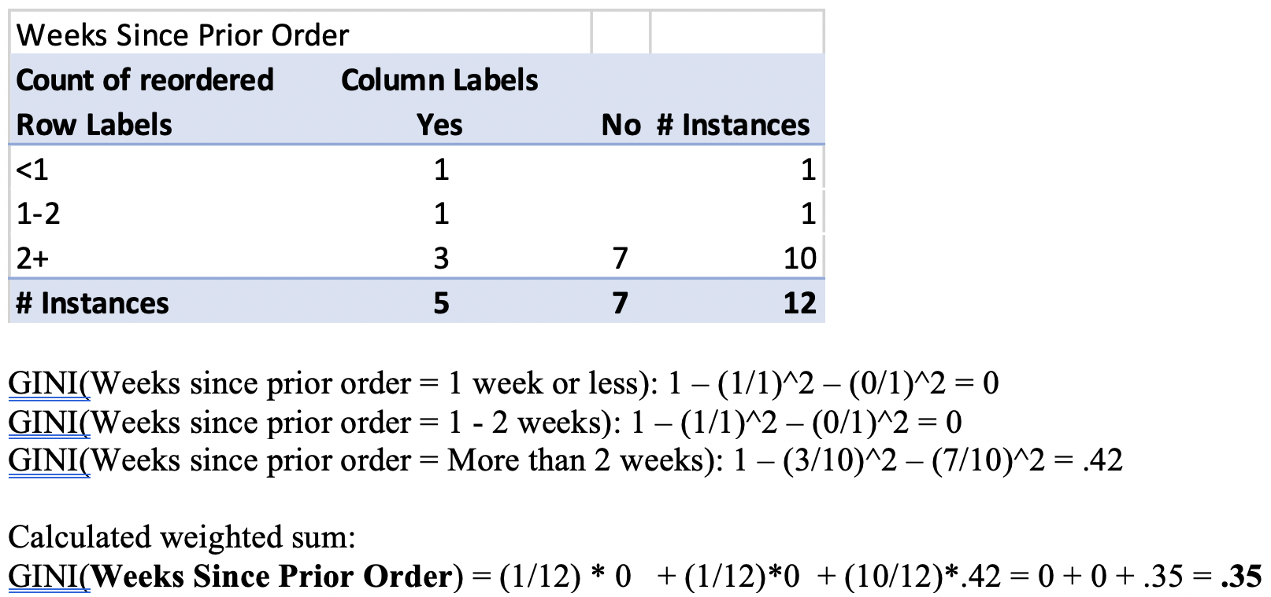
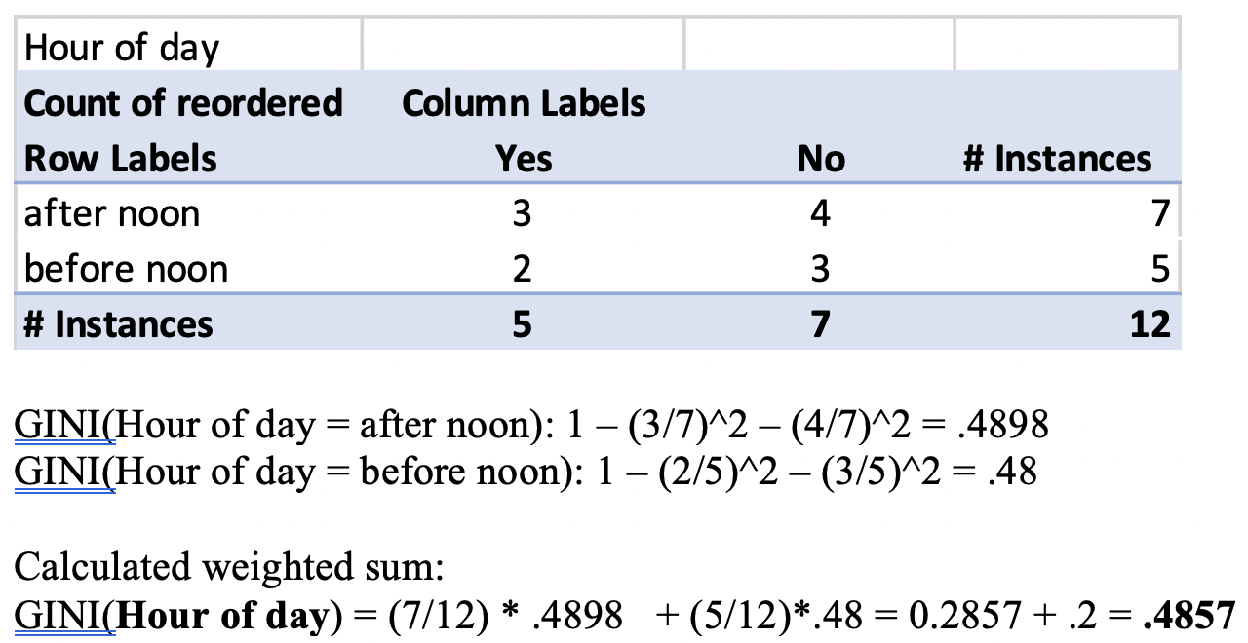
Notes:
We then did these calculations for the other 3 features.

Slide 10
Feature | Gini Impurity
Day of week | .4833
Hour of day | .4857
Weeks since prior order | .35
Department | .2917
Root node
Notes:
When we compare the Gini Impurity numbers of the 4 possible nodes, we see that Department has the lowest Gini Impurity.
Therefore this is our root node.

Slide 11
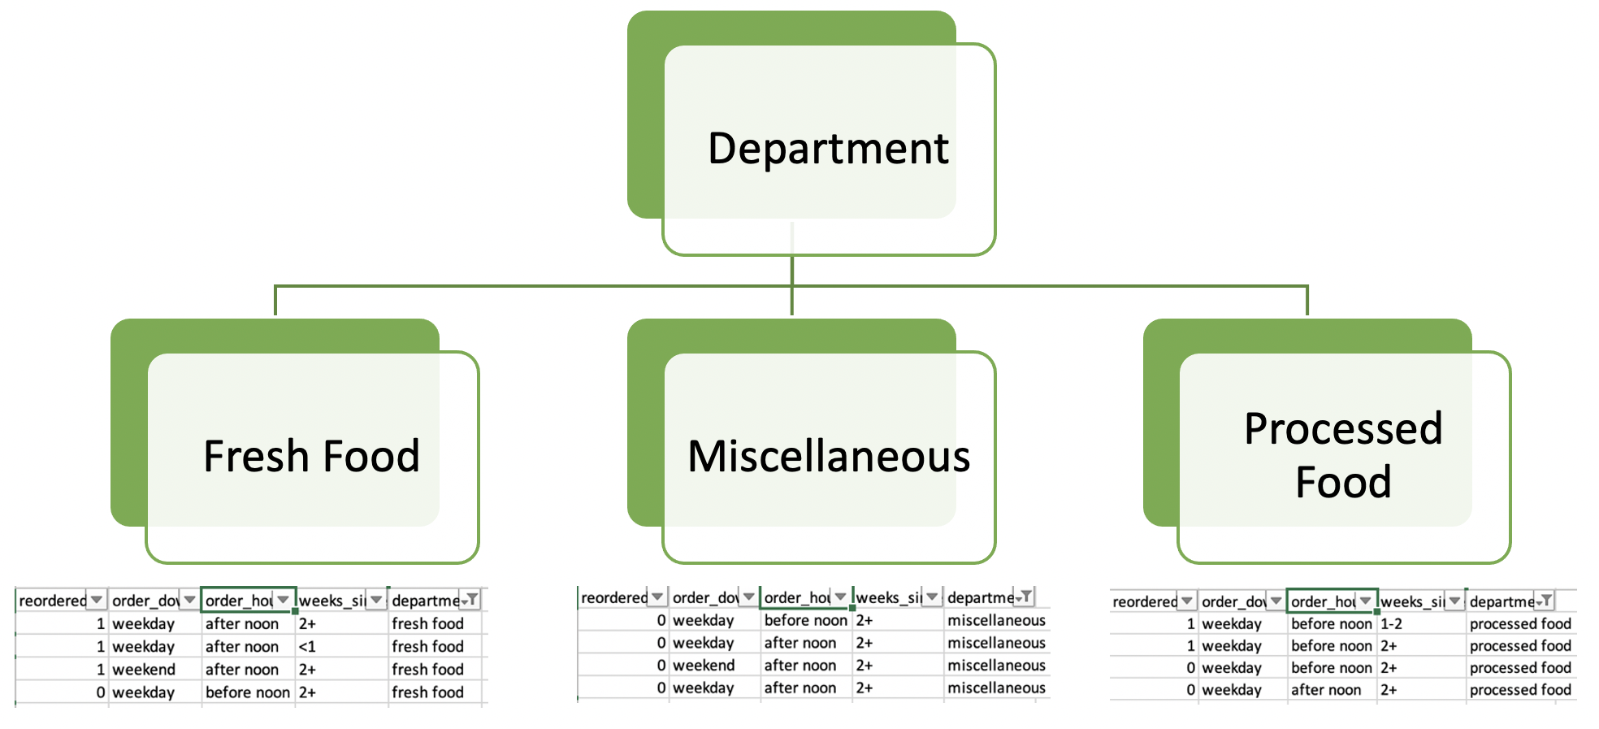
Notes:
With our root node determined, we then went through the Gini Impurity calculations again for each possible feature under each of the nodes.
Don’t worry, we won’t go through all the calculations to get to our completed tree. Although we did come across something interesting.

Slide 12
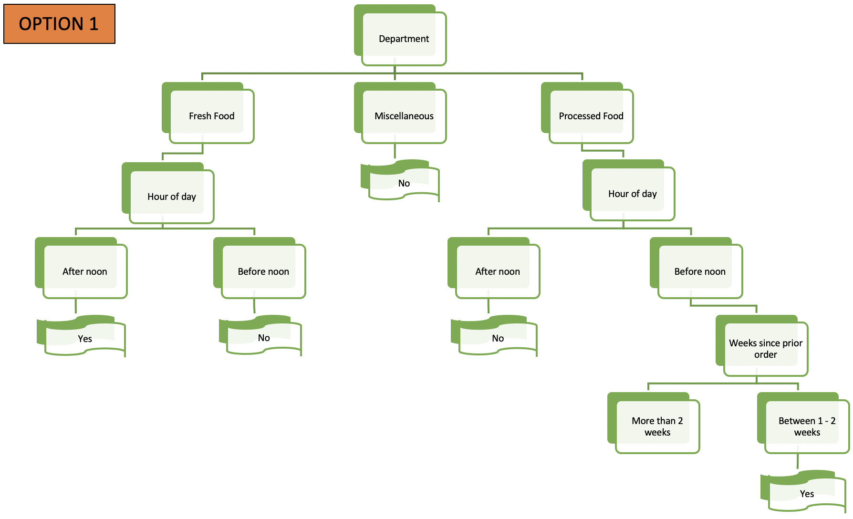
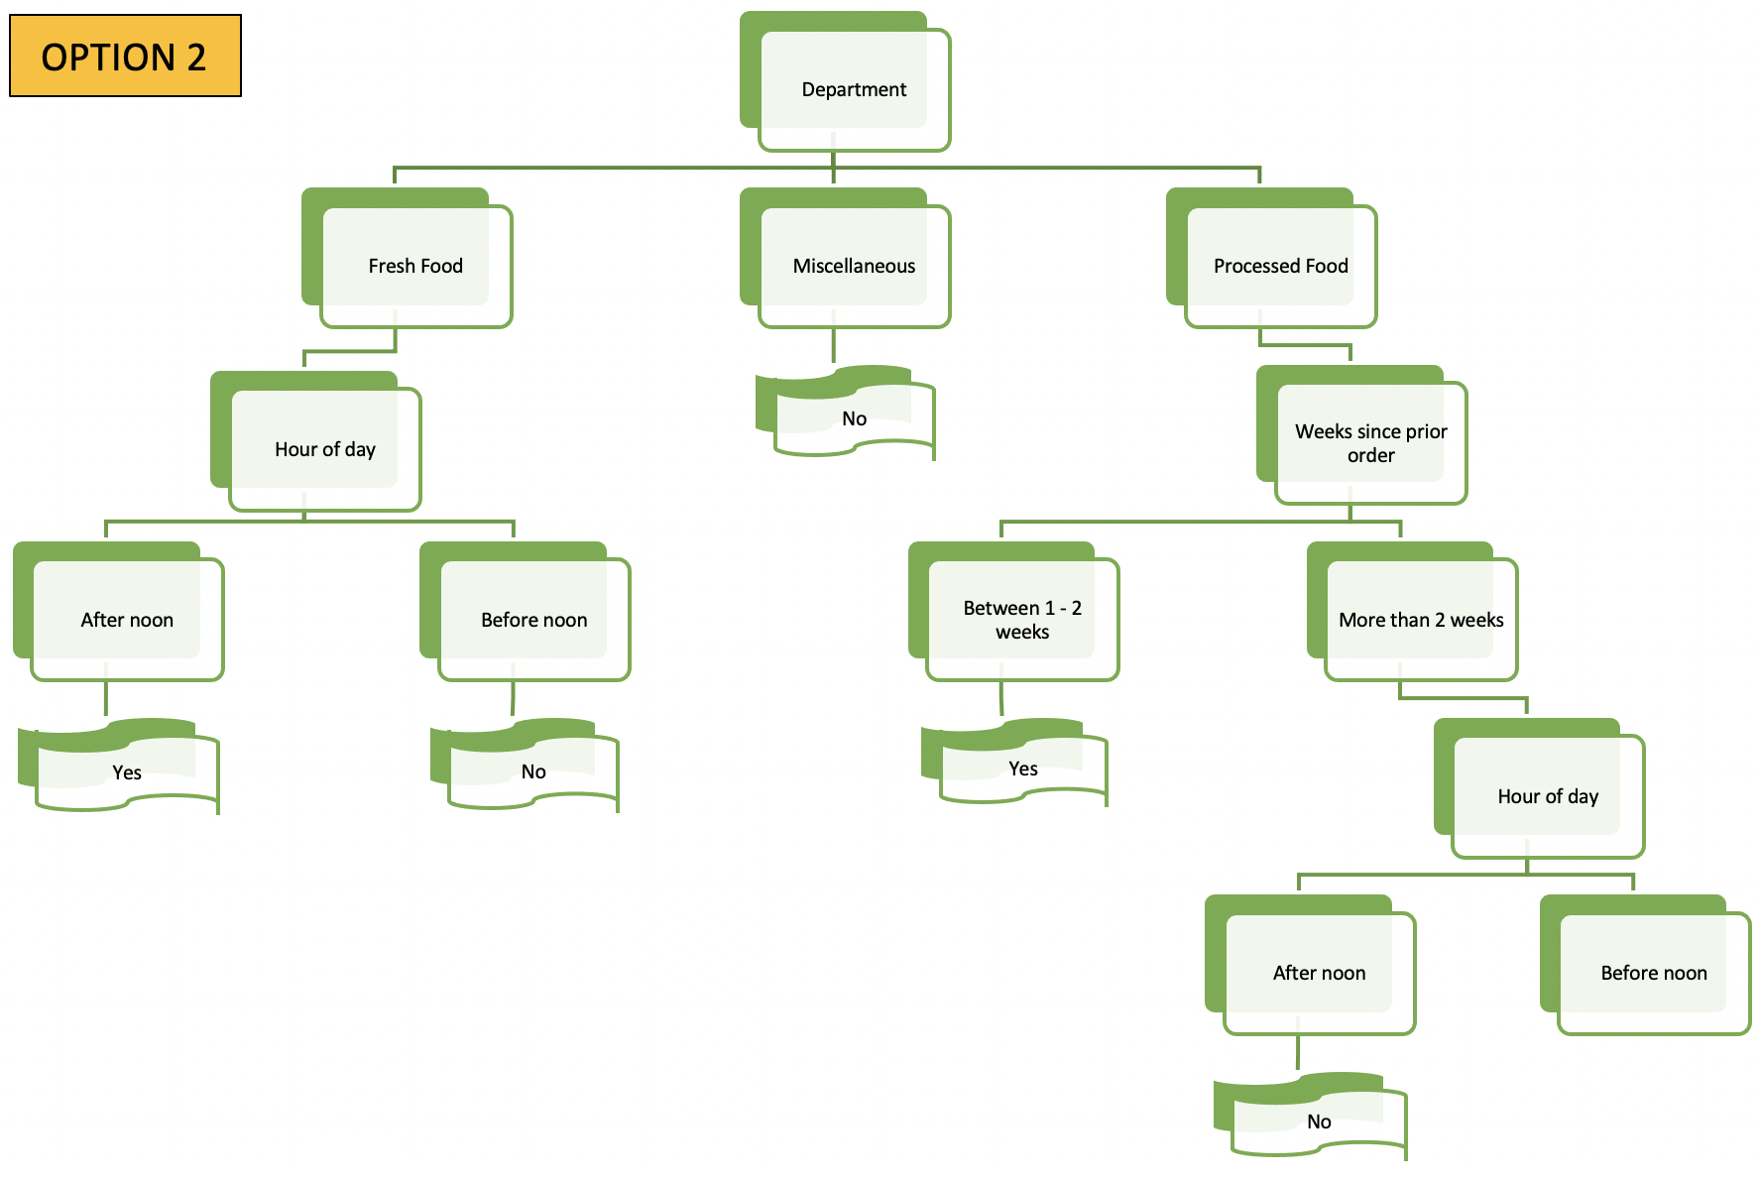
Notes:
On our Processed Food branch, we came across a tie or when two features had the same Gini Impurity number.
In that case, we could either randomly selected a feature as the decision node, or we could create two different versions of our tree.

Slide 13

Notes:
Carey: Now that we had a thorough understanding of the mechanics of creating a decision tree, we moved to Python to address the 1.3M row dataset.
Again, breaking down a larger problem into a smaller problem, we first used Python on a 1000 row subset and once we were comfortable with the process, we used it on the full 1.3M dataset.
To create our Python program, we used the Scikit Learn package to build a classification tree, Pandas library to load and manipulate data and the Matplotlib library to help us visualize the decision tree.

Slide 14
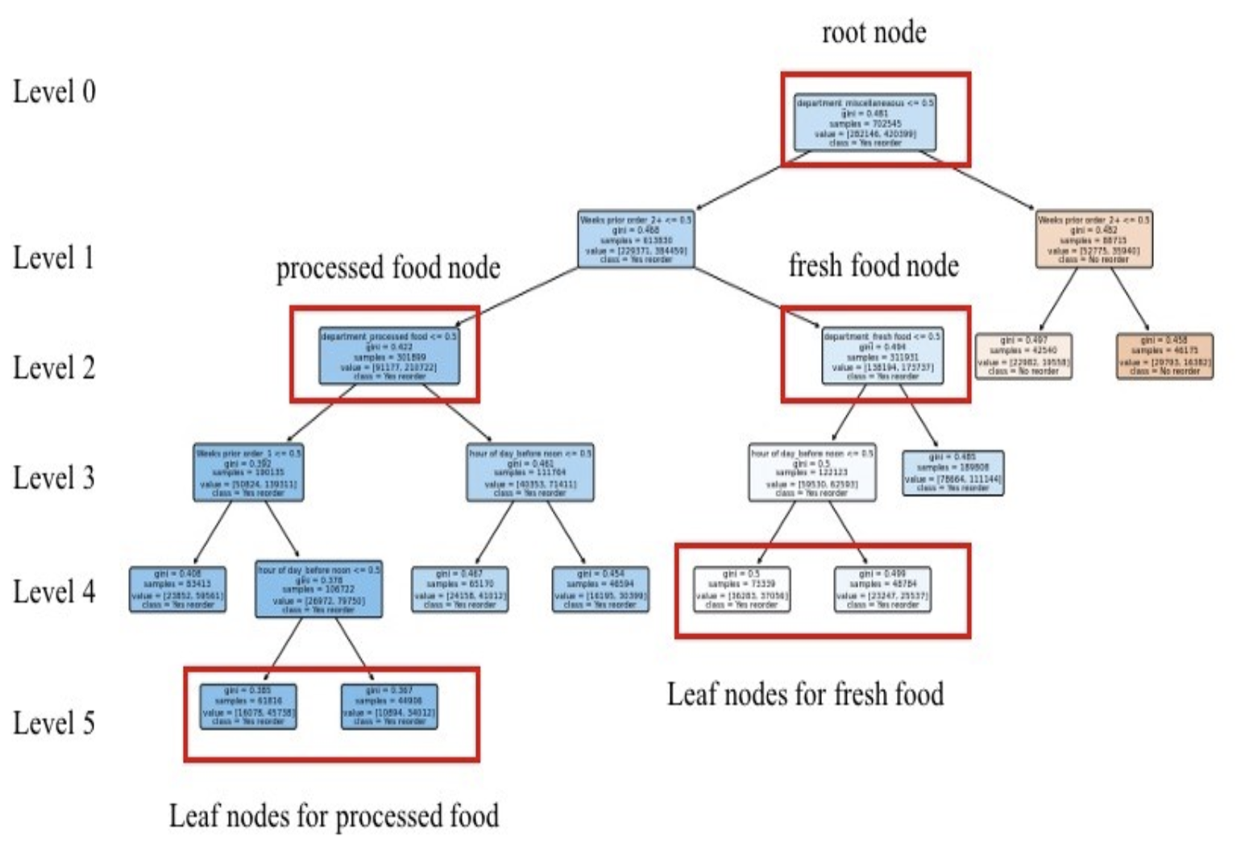
Notes:
There is a lot of detail we could go into about the Python process, but we’ll focus on the math we learned in this course.
In the Python program, the leaf nodes aren’t just yes or no as was the case in our simple sample. These leaf nodes are blended, but still classified in a meaningful way.
Apologies for the image but the dataset had too many nodes even after applying a filter to reduce the maximum leaf nodes.
While writing the code, we classified code into two types: Yes reorder, blue in color and No reorder, orange in color. Also note, darker the node, lower the Gini impurity means purer the node
So, we calculated the root node probability to be 60%.

Slide 15
60% probability of reorder
Notes:
When we get more data, such as an order being a processed food, the probability is adjusted. This probability is measured from the leaf nodes on level 5, with the lower Gini index, meaning purer of the two. In this case it was the left leaf node on level 5 and the probability for reorder calculated was 74%

Slide 16
60% probability of reorder
74% probability of reorder
Notes:
Similarly, the probability for fresh food is measured from the leaf nodes on level 4,
with the right left leaf node which has the lower Gini index and the probability for reorder if it is a fresh food is 56%.

Slide 17
60% probability of reorder
56% probability of reorder
74% probability of reorder
Notes:
Therefore, we were able to get an answer to our question: “What items are predominantly reordered at grocery stores by customers across the United States?”
The answer is that Processed foods are more likely to be reordered than fresh foods.
Another interesting fact is that if you look at the flow of the arrow, we can also apply the concept of Bayes theorem to our decision tree where the root node with a (P) of 60% acts as a prior (P). When we walk from level 0 to level 5, we see that the prior probability increases from 60% to 74% for reorder of processed food with new information such as the hour of day the order was placed. This is the posterior probability.

Slide 18
LIMITATIONS
Notes:
So according to this dataset, we got an answer to the question, but we need to understand the limitations of this project:
The most important one for decision trees in general is overfitting. Overfitting means that the data is too well trained on the dataset that it can’t be used on other datasets. But, it can be overcome by pruning which is a technique that can reduce the size of the decision trees by removing redundant and unnecessary nodes in the tree. However, that was out of scope this time.

Slide 19
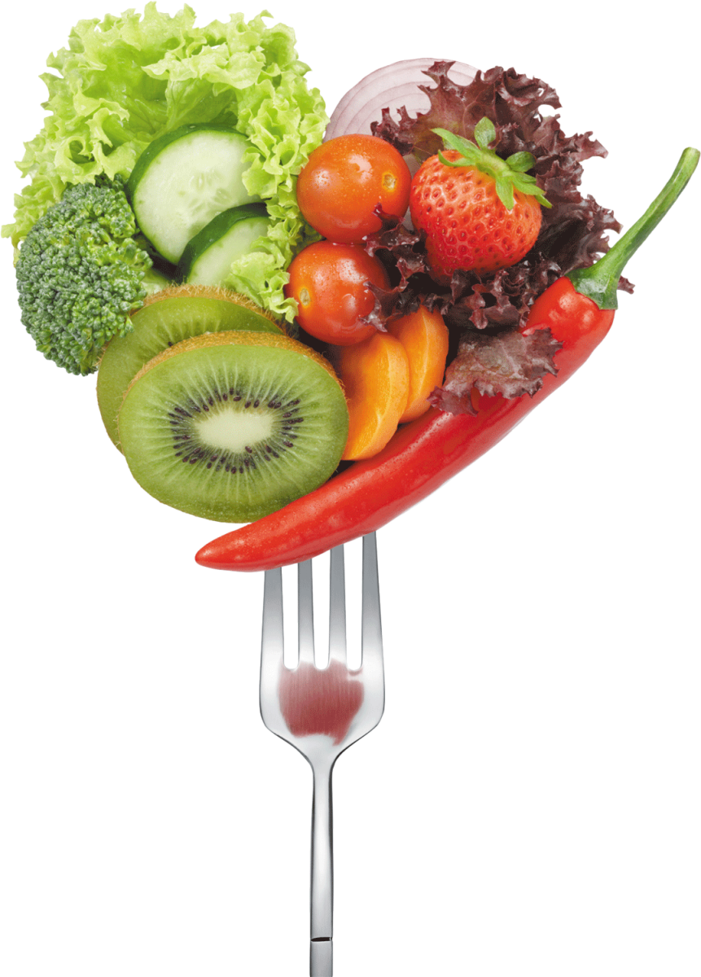
Thank you
Notes:
Finally, we want to thank Richard and Nickyta for their guidance as we learned about decision trees and this concludes our presentation.

